Slide 1
Berkeley Sockets

Slide 2
Topics
Client-server model
Sockets interface: Address structure, byte ordering, port no
Socket primitives: socket, bind,listen…
Example code for echoclient and echoserver
Programming Assignment

Slide 3
Client/sever model
Client asks (request) – server provides (response)
Typically: single server - multiple clients
The server does not need to know anything about the client
  even that it exists
The client should always know something about the server
  at least where it is located
1. Client sends request
Client
process
Server
process
Resource
4. Client
handles
response
3. Server sends response
2. Server
handles
request
Note: clients and servers are processes running on hosts
(can be the same or different hosts).
Notes:
Both Can run on the same machine

Slide 4

Sockets as means for inter-process communication (IPC)
application layer
application layer
Client Process
Internet
Server Process
Socket
Socket
OS network
stack
OS network
stack
transport layer (TCP/UDP)
transport layer (TCP/UDP)
Internet
network layer (IP)
network layer (IP)
link layer (e.g. ethernet)
link layer (e.g. ethernet)
Internet
physical layer
physical layer
The interface that the OS provides to its networking subsystem

Slide 5
Sockets
What is a socket?
  To the kernel, a socket is an endpoint of communication.
  To an application, a socket is a file descriptor that lets the application read/write from/to the network.
    Remember: All Unix I/O devices, including networks, are modeled as files.
Clients and servers communicate with each by reading from and writing to socket descriptors.
The main distinction between regular file I/O and socket I/O is how the application “opens” the socket descriptors.

Slide 6
Internet Connections (TCP/IP)
Address the machine on the network
  By IP address
Address the process
  By the “port”-number
The pair of IP-address + port – makes up a “socket-address”
Client socket address
128.2.194.242:3479
Server socket address
208.216.181.15:80
Client
Server
(port 80)
Connection socket pair
(128.2.194.242:3479, 208.216.181.15:80)
Client host address
128.2.194.242
Server host address
208.216.181.15
Note: 3479 is an
ephemeral port allocated
by the kernel
Note: 80 is a well-known port
associated with Web servers

Slide 7
Clients
Examples of client programs
  Web browsers, ftp, telnet, ssh
How does a client find the server?
  The IP address in the server socket address identifies the host
  The (well-known) port in the server socket address identifies the service, and thus implicitly identifies the server process that performs that service.
  Examples of well known ports
    Port 7: Echo server
    Port 23: Telnet server
    Port 25: Mail server
    Port 80: Web server

Slide 8
Using Ports to Identify Services
Server host 128.2.194.242
Client host
Service request for
128.2.194.242:80
(i.e., the Web server)
Web server
(port 80)
Client
Kernel
Echo server
(port 7)
Service request for
128.2.194.242:7
(i.e., the echo server)
Web server
(port 80)
Client
Kernel
Echo server
(port 7)

Slide 9
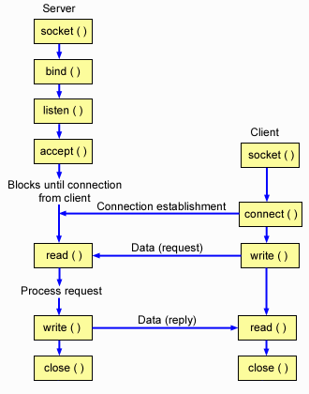
A TCP Server – Client Interaction

Slide 10
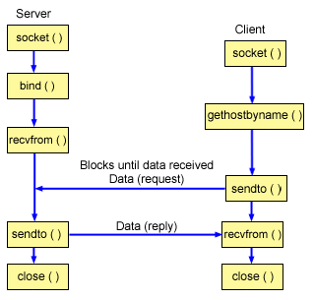
A UDP Server – Client Interaction

Slide 11
Data Structures
Let us now look at the data structures used
to hold all the address Information:
Struct sockaddr {
unsigned short sa_family;
char sa_data[14];
}
Struct sockaddr_in {
short sin_family;
unsigned short sin_port; // Port Number
struct in_addr sin_addr; // IP Address
char sin_zero[8];
}
Struct in_addr {
unsigned long s_addr; // 4 bytes long
}

Slide 12
Byte Ordering
Byte ordering is the attribute of a system which indicates whether integers are stored / represented left to right or right to left.
Example 1: short int x = 0xAABB (hex)
This can be stored in memory as 2 adjacent bytes as either (0xaa , 0xbb) or as (0xbb, 0xaa).
Big Endian:
Byte Value : [0xAA] [0xBB]
Memory : [ 0 ] [ 1 ]
Little Endian:
Byte Value : [0xBB] [0xAA]
Memory : [ 0 ] [ 1 ]

Slide 13
Byte Ordering
Example 2: int x = 0xAABBCCDD
This 4 byte long integer can be represented in the same 2 orderings:
Big Endian:
Byte Value: [0xAA] [0xBB] [0xCC] [0xDD]
Memory: [ 0 ] [ 1 ] [ 2 ] [ 3 ]
Little Endian:
Byte Value: [0xDD] [0xCC] [0xBB] [0xAA]
Memory: [ 0 ] [ 1 ] [ 2 ] [ 3 ]
All Network data is sent in Big Endian format.
In the networking world we call this representation as Network Byte Order and native representation on the host as Host Byte Order.
We convert all data into Network Byte Order before transmission.

Slide 14
Some utility functions :
Byte Ordering:
Host Byte Order to Network Byte Order:
htons() , htonl()
Network Byte Order to Host Byte Order:
ntohs() , ntohl()
IP Address format:
Ascii dotted to Binary: inet_aton()
Binary to Ascii dotted: inet_ntoa()
Char string in dotted dec to 32 bit IP : inet_addr(char *ptr)
Many others exist …… explore the man pages :D

Slide 15
syscalls()
We will now describe the following calls in detail :
Socket()
Bind()
Listen()
Accept()
Connect()
Read() / Send() / Sendto()
Write() / Recv() / Recvfrom()
Close()

Slide 16
Socket() – A Connection Endpoint
This creates an endpoint for a network connection.
int socket(int doman, int type, int protocol)
domain = AF_INET (IPv4 communication)
type = SOCK_STREAM (TCP) , SOCK_DGRAM (UDP)
protocol = 0 (for our discussion)
Example : socket(AF_INET, SOCK_STREAM, 0);
This will create a TCP socket.
The call returns a socket descriptor on success and -1 on an error.

Slide 17
Bind() – Attaching to an IP and Port
A server process calls bind to attach itself to a specific port and IP address.
int bind(int sockfd, struct sockaddr *my_addr, socklen_t addrlen)
sockfd = socket descriptor returned by socket()
my_addr = pointer to a valid sockaddr_in structure cast as a sockaddr * pointer
addrlen = length of the sockaddr_in structure
Example :
struct sockaddr_in my;
bzero( (char *)&my, sizeof(my))
my.sin_family = AF_INET;
my.sin_port = htons(80);
my.sin_addr.s_addr =htonl( INADDR_ANY);
bind(sock, (struct sockaddr *)&my, sizeof(my));

Slide 18
Listen() – Wait for a connection
The server process calls listen to tell the kernel to initialize a wait queue of connections for this socket.
int listen(int sock, int backlog)
sock = socket returned by socket()
backlog = Maximum length of the pending connections queue
Example: Listen(sock, 10);
This will allow a maximum of 10 connections to be in pending state.

Slide 19
Accept() – A new connection !
Accept is called by a Server process to accept new connections from new clients trying to connect to the server.
int accept(int socket, (struct sockaddr *)&client, *client_len)
socket = the socket in listen state
client = will hold the new client’s information when accept returns
client_len = pointer to size of the client structure
Example :
struct sockaddr_in client;
int len = sizeof(client);
Accept(sock, (struct sockaddr *)&client, &len);

Slide 20
Connect() – connect to a service
Connect is called by a client to connect to a server port.
int connect(int sock, (struct sockaddr *)&server_addr, socklen_t len)
sock: a socket returned by socket()
server_addr: a sockaddr_in struct pointer filled with all the remote server details and cast as a sockaddr struct pointer
len: size of the server_addr struct
Example:
connect(sock, (struct sockaddr *)server_addr, len);

Slide 21
Send / Recv – Finally Data !!
Send(), Recv() , Read() , Write() etc calls are used to send and receive data .
Int send(int sock, void *mesg, size_t len, int flags)
Int recv(int sock, void *mesg, size_t len, int flags)
sock = A connected socket
mesg = Pointer to a buffer to send/receive data from/in .
len = Size of the message buffer
flags = 0 (for our purpose)
The return value is the number of bytes actually sent/received.
Example:
char send_buffer[1024];
char recv_buffer[1024];
int sent_bytes;
int recvd_bytes;
sent_bytes = send(sock, send_buffer, 1024, 0);
recvd_bytes = recv(sock, recv_buffer, 1024, 0);

Slide 22
Close() – Bye ..Bye !
Close signals the end of communication between a server-client pair. This effectively closes the socket.
int close(int sock)
sock = the socket to close
Example :
close(sock);

Slide 23
SEND (DGRAM-style): int sendto(int sockfd, const void *msg, int len, int flags, const struct sockaddr *to, int tolen);
  msg: message you want to send
  len: length of the message
  flags := 0
  to: socket address of the remote process
  tolen: = sizeof(struct sockaddr)
  returned: the number of bytes actually sent
RECEIVE (DGRAM-style): int recvfrom(int sockfd, void *buf, int len, unsigned int flags, struct sockaddr *from, int *fromlen);
  buf: buffer to receive the message
  len: length of the buffer (“don’t give me more!”)
  from: socket address of the process that sent the data
  fromlen:= sizeof(struct sockaddr)
  flags := 0
  returned: the number of bytes received
CLOSE: close (socketfd);

Slide 24
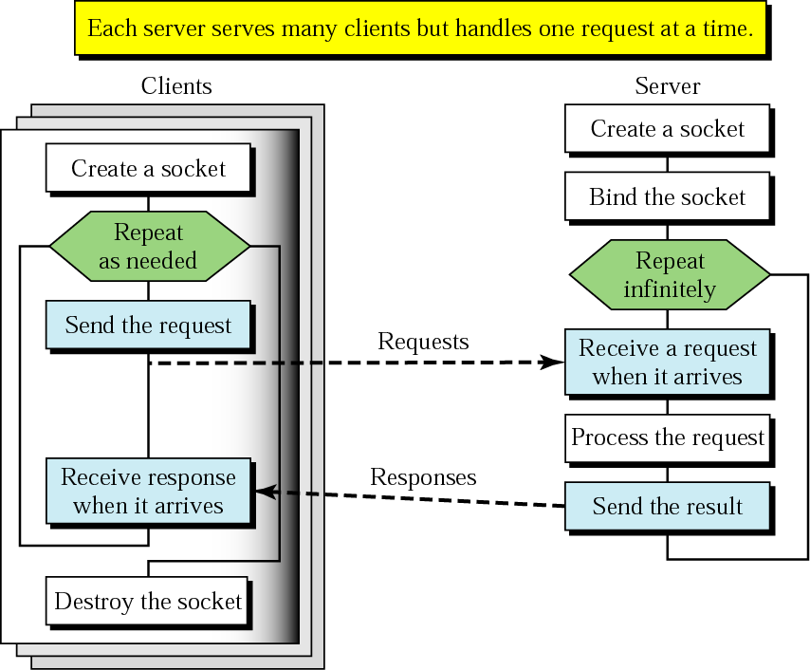
Client+server: connectionless
CREATE
BIND
SEND
RECEIVE
SEND
CLOSE

Slide 25
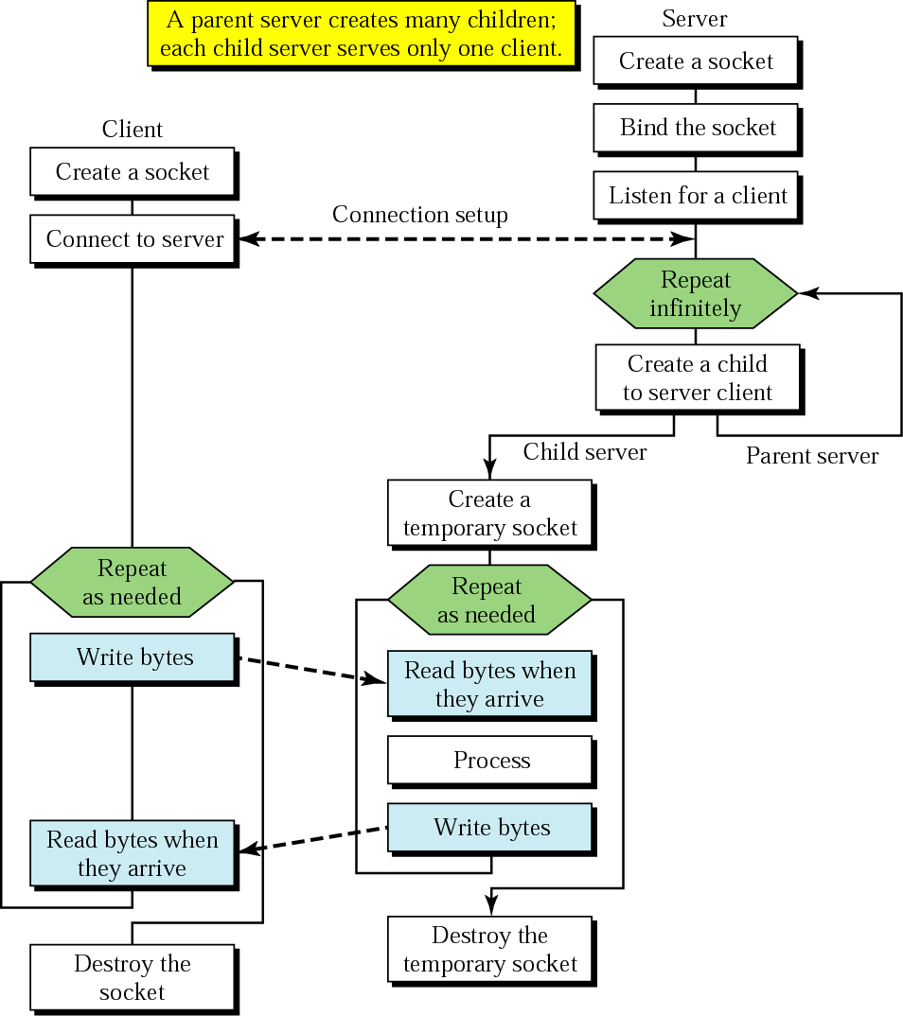
Client+server: connection-oriented
BIND
SOCKET
LISTEN
CONNECT
TCP three-way handshake
ACCEPT
SEND
RECEIVE
SEND
RECEIVE
CLOSE
Concurrent server

Slide 26
EchoClient.c – #include’s
#include <stdio.h> /* for printf() and fprintf() */
#include <sys/socket.h> /* for socket(), connect(),
sendto(), and recvfrom() */
#include <arpa/inet.h> /* for sockaddr_in and
inet_addr() */
#include <stdlib.h> /* for atoi() and exit() */
#include <string.h> /* for memset() */
#include <unistd.h> /* for close() */
#define ECHOMAX 255 /* Longest string to echo */

Slide 27
EchoClient.c -variable declarations
int main(int argc, char *argv[])
{
int sock; /* Socket descriptor */
struct sockaddr_in echoServAddr; /* Echo server address */
struct sockaddr_in fromAddr; /* Source address of echo */
unsigned short echoServPort =7; /* Echo server port */
unsigned int fromSize; /* address size for recvfrom() */
char *servIP=“172.24.23.4”; /* IP address of server */
char *echoString=“I hope this works”; /* String to send to echo server */
char echoBuffer[ECHOMAX+1]; /* Buffer for receiving echoed string */
int echoStringLen; /* Length of string to echo */
int respStringLen; /* Length of received response */

Slide 28
EchoClient.c - creating the socket and sending
/* Create a datagram/UDP socket */
sock = socket(AF_INET, SOCK_DGRAM, 0);
/* Construct the server address structure */
memset(&echoServAddr, 0, sizeof(echoServAddr)); /* Zero out structure */
echoServAddr.sin_family = AF_INET; /* Internet addr family */
echoServAddr.sin_addr.s_addr = htonl(servIP); /* Server IP address */
echoServAddr.sin_port = htons(echoServPort); /* Server port */
/* Send the string to the server */
sendto(sock, echoString, echoStringLen, 0, (struct sockaddr *) &echoServAddr, sizeof(echoServAddr);
/* Recv a response */

Slide 29
EchoClient.c – receiving and printing
fromSize = sizeof(fromAddr);
recvfrom(sock, echoBuffer, ECHOMAX, 0, (struct sockaddr *) &fromAddr, &fromSize);
/* Error checks like packet is received from the same server*/
/* null-terminate the received data */
echoBuffer[echoStringLen] = '\0';
printf("Received: %s\n", echoBuffer); /* Print the echoed arg */
close(sock);
exit(0);
} /* end of main () */

Slide 30
EchoServer.c
int main(int argc, char *argv[])
{
int sock; /* Socket */
struct sockaddr_in echoServAddr; /* Local address */
struct sockaddr_in echoClntAddr; /* Client address */
unsigned int cliAddrLen; /* Length of incoming message */
char echoBuffer[ECHOMAX]; /* Buffer for echo string */
unsigned short echoServPort =7; /* Server port */
int recvMsgSize; /* Size of received message */
/* Create socket for sending/receiving datagrams */
sock = socket(AF_INET, SOCK_DGRAM, 0);
/* Construct local address structure */
memset(&echoServAddr, 0, sizeof(echoServAddr)); /* Zero out structure */
echoServAddr.sin_family = AF_INET; /* Internet address family */
echoServAddr.sin_addr.s_addr = htonl(“172.24.23.4”);
echoServAddr.sin_port = htons(echoServPort); /* Local port */
/* Bind to the local address */
bind(sock, (struct sockaddr *) &echoServAddr, sizeof(echoServAddr);

Slide 31
for (;;) /* Run forever */
{
cliAddrLen = sizeof(echoClntAddr);
/* Block until receive message from a client */
recvMsgSize = recvfrom(sock, echoBuffer, ECHOMAX, 0,
(struct sockaddr *) &echoClntAddr, &cliAddrLen);
printf("Handling client %s\n", inet_ntoa(echoClntAddr.sin_addr));
/* Send received datagram back to the client */
sendto(sock, echoBuffer, recvMsgSize, 0,
(struct sockaddr *) &echoClntAddr, sizeof(echoClntAddr);
}
} /* end of main () */
Error handling is must

Slide 32
More information…
Socket programming
  W. Richard Stevens, UNIX Network Programming
  Infinite number of online resources
  http://www.cs.rpi.edu/courses/sysprog/sockets/sock.html
GDB
  Official GDB homepage: http://www.gnu.org/software/gdb/gdb.html
  GDB primer: http://www.cs.pitt.edu/~mosse/gdb-note.html

